Slide 1
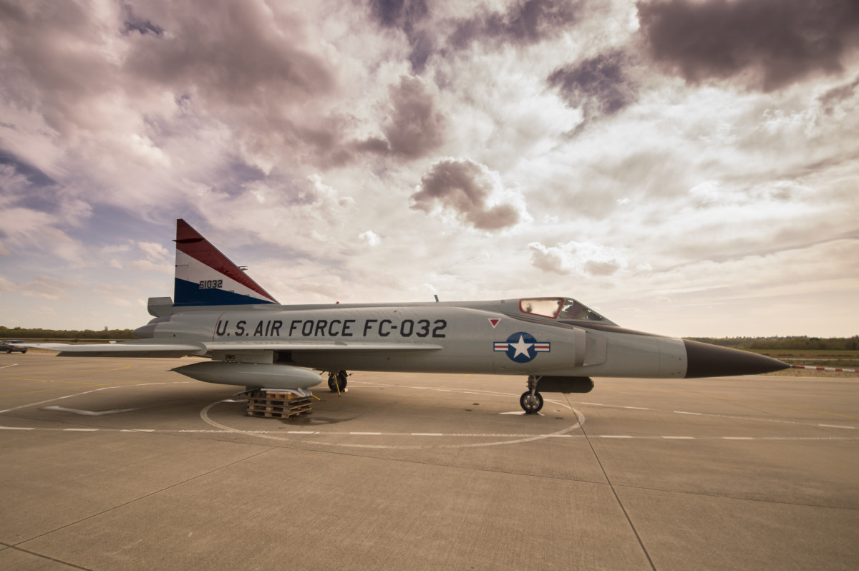
AirFly Insights: Data Visualization and Analysis of Airline Operations
Data-Driven Visualizations to Improve Reliability
Mentor Name:
Rahul Yadav
Presented By:
Erra Sanjana

Slide 2
Project Overview
AirFly Insights is a data visualization and analysis project focused on airline operations.
The project analyzes flight data to identify trends in flight volume, delays, and cancellations.
Python-based data analysis and visualization techniques are used to extract meaningful insights.
The goal is to support data-driven decision-making for improving airline reliability.

Slide 3

Objectives
Analyze airline flight volume and route distribution.
Identify seasonal, weekly, and hourly flight patterns.
Study major causes of flight delays and cancellations.
Provide actionable insights to improve operational efficiency.
This Photo by Unknown Author is licensed under CC BY-SA

Slide 4
Executive Summary
This project analyzes airline flight operations data to understand patterns in flight volume, delays, and cancellations.
Flight activity is highly concentrated among a few major airlines, with peak demand during summer months and weekdays.
Morning flights show better on-time performance, while delays increase as the day progresses due to cumulative operational effects.
Weather and airline-related issues are the primary causes of delays and cancellations, impacting overall operational efficiency.

Slide 5
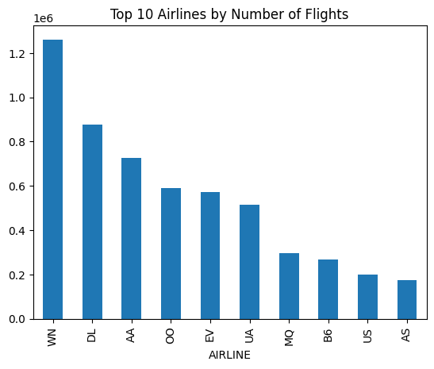
Airline Volume Analysis
Southwest Airlines (WN) operates the highest number of flights, indicating strong market dominance.
Delta (DL) and American Airlines (AA) follow, showing that a few major airlines control most flight operations.
Smaller carriers like Alaska (AS) and US Airways (US) operate significantly fewer flights, highlighting market concentration.

Slide 6
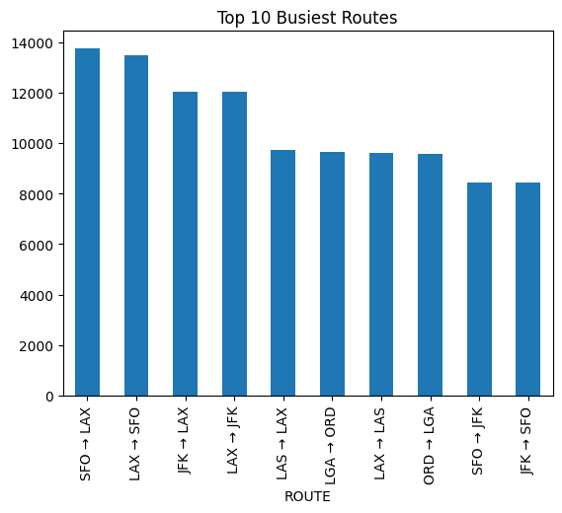
Route Density Analysis
The busiest routes are primarily between major metropolitan hubs such as SFO–LAX, LAX–SFO, and JFK–LAX.
High traffic is observed on both directions of the same routes, indicating strong two-way passenger demand.
These high-density routes are more prone to congestion, increasing the likelihood of delays during peak hours.

Slide 7
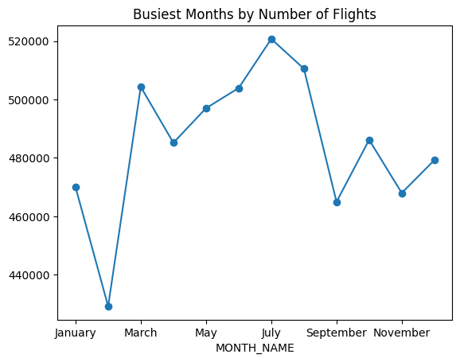
Monthly Trends
Flight activity shows a clear seasonal pattern, with volumes increasing during the summer months.
July records the highest number of flights, indicating peak travel demand.
February has the lowest flight volume, reflecting off-season travel and reduced operations.

Slide 8
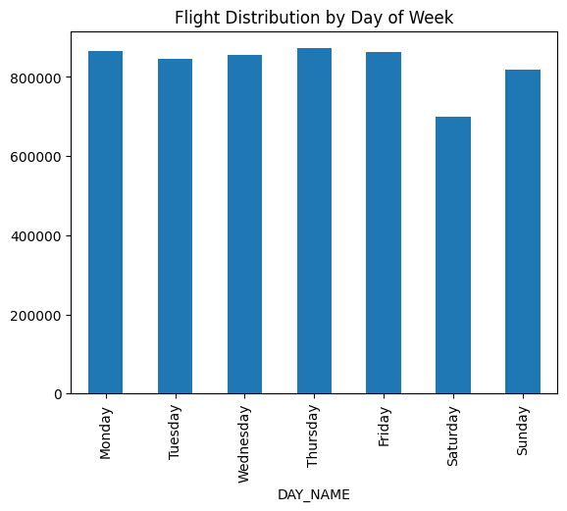
Weekly Flight Trends
Flight activity is consistently higher on weekdays, with Thursday and Friday showing the highest volumes.
Saturday records the lowest number of flights, indicating reduced leisure and business travel.
Increased weekday traffic leads to higher congestion and a greater risk of operational delays.

Slide 9
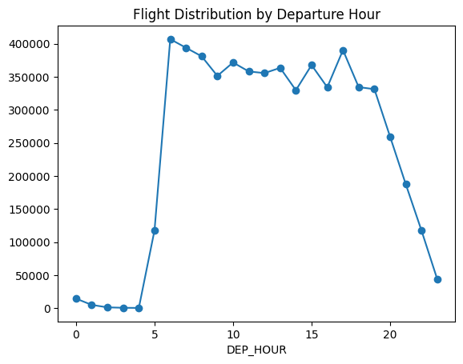
Hourly Trends
Flight activity is minimal during late night and early morning hours.
Operational load peaks between 6 AM and 6 PM, indicating heavy daytime traffic.
High flight concentration during peak hours increases congestion and contributes to delay propagation.

Slide 10
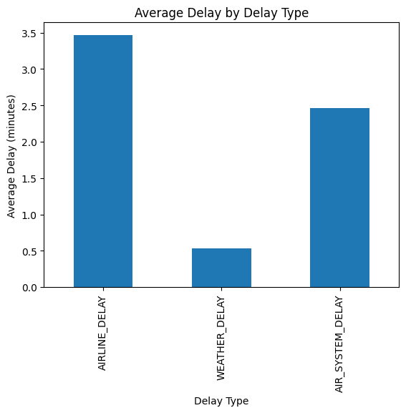
Delay Cause Analysis
Airline-related delays contribute the highest average delay, indicating operational and scheduling inefficiencies.
Air system delays are the second major contributor, reflecting congestion in air traffic management.
Weather delays have the least average impact compared to operational factors.

Slide 11
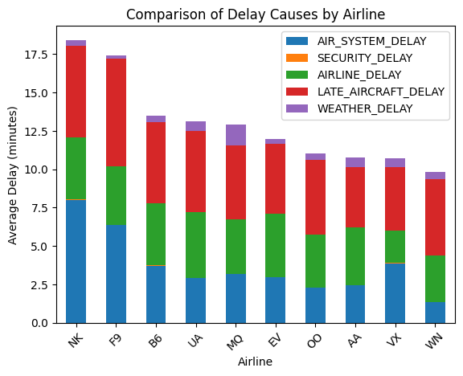
Airline-wise Comparison of Delay Causes
Late aircraft delay is the major cause of delays across most airlines.
Air system delays are high for some airlines, indicating congestion and traffic control issues.
Airline-related delays reflect internal operational inefficiencies.
Weather and security delays have minimal impact compared to other delay types.

Slide 12
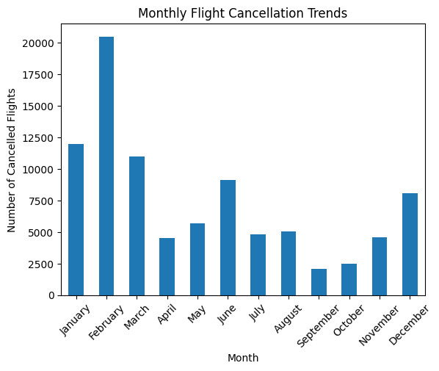
Cancellation Trends
Flight cancellations are highest during winter months, especially February and January.
Severe weather conditions significantly contribute to increased cancellations.
Summer and early autumn months show relatively lower cancellation rates.
Seasonal patterns highlight the need for better contingency planning in peak-risk months.

Slide 13
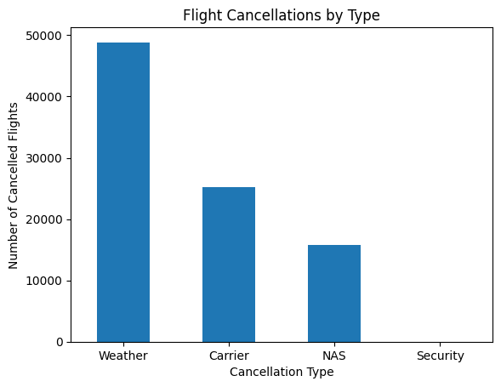
Cancellation Reasons
Weather conditions are the primary cause of flight cancellations.
Carrier-related operational issues contribute significantly to cancellations.
NAS (air traffic system) issues cause a moderate number of cancellations.
Security-related cancellations are minimal compared to other factors.

Slide 14
Strategic Recommendations
Improve aircraft turnaround planning to reduce late aircraft delays.
Optimize flight schedules on busy routes and peak hours to manage congestion.
Strengthen weather monitoring and contingency plans during high-risk months.
Enhance coordination with air traffic control to minimize air system delays.

Slide 15
Future Scope
Apply machine learning models to predict flight delays in advance.
Perform real-time analysis using live flight and weather data.
Extend analysis to include airport-wise and route-wise performance optimization.
Develop an interactive dashboard for airlines and passengers to monitor delays.

Slide 16
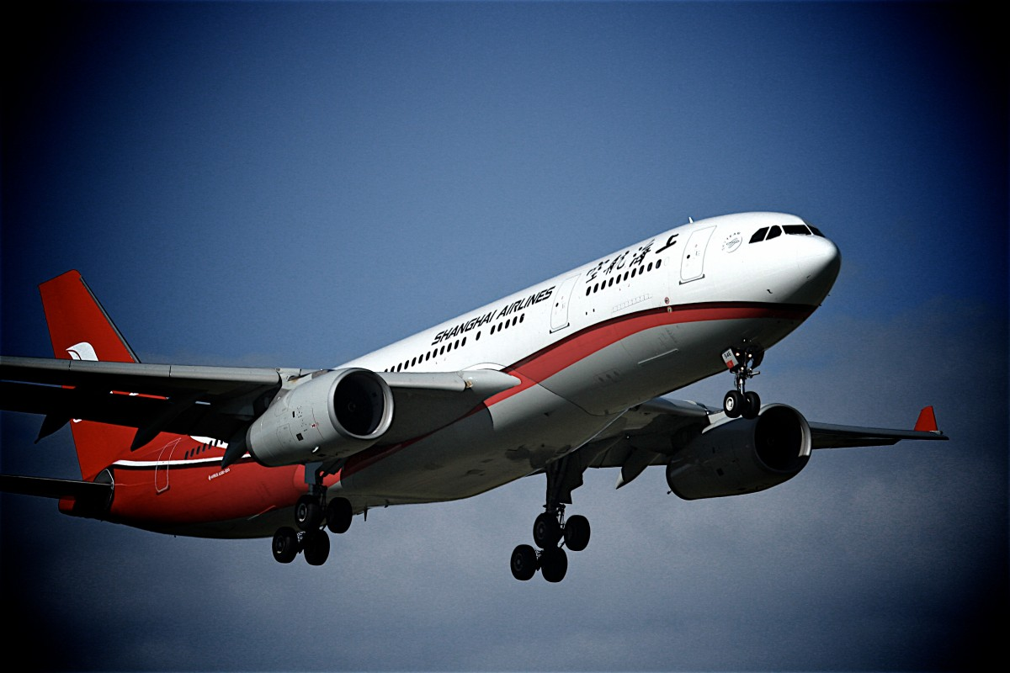
Conclusion
Flight operations are concentrated among major airlines and busy routes.
Peak travel occurs during summer months, weekdays, and daytime hours.
Late aircraft, airline operations, and air system congestion are the primary delay causes.
Data-driven insights can help airlines reduce delays and improve operational efficiency.

Slide 17
ANY QUESTIONS?

Slide 18
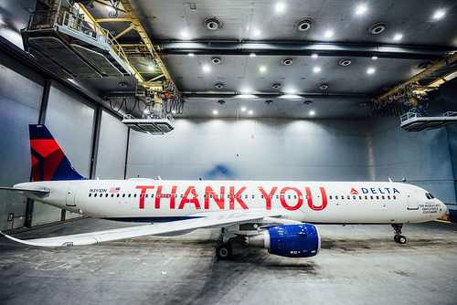
THANK YOU!

